Slide 1
Sales Insights Presentation for 2011 – CEO & CMO Brief
Presented by:
Islamiyat Damilola Abdulwasiu
This report summarizes data-driven insights based on online sales performance in 2011.
Key focus areas:
Monthly revenue trend
Country-level performance
Top customers
Regional demand map

Slide 2
Monthly Revenue Trend for 2011
Understanding seasonality and forecasting patterns
The chart shows how revenue changed month by month in 2011.
A noticeable peak in revenue occurred in November.
Q4 drop may indicate seasonal shifts or reduced campaigns.
Helps guide inventory and marketing planning.

Slide 3
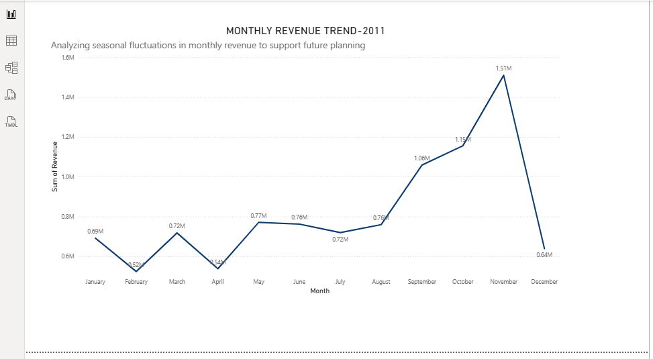
Monthly Revenue Trend for 2011

Slide 4
Top 10 Countries by Revenue and Quantity Sold (Excl. UK)
Identifying regional strengths for future focus
Netherlands, EIRE, and Germany lead in both revenue and volume.
Excludes the United Kingdom as per CMO's request.
These countries show consistent demand.
High potential for expansion, regional promotions, or market entry.

Slide 5
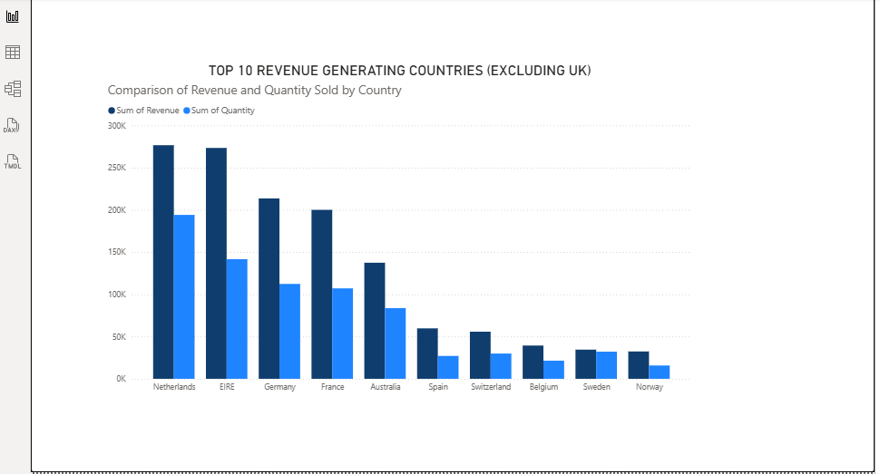
Top 10 Countries by Revenue and Quantity Sold (Excl. UK)

Slide 6
Top 10 Customers by Revenue
Prioritizing high-value relationships
Customer 14466 brings in the highest revenue.
Other key customers include 18102 and 14056.
These 10 customers contribute significantly to overall revenue.
Opportunity to design loyalty strategies and personalized offers.

Slide 7
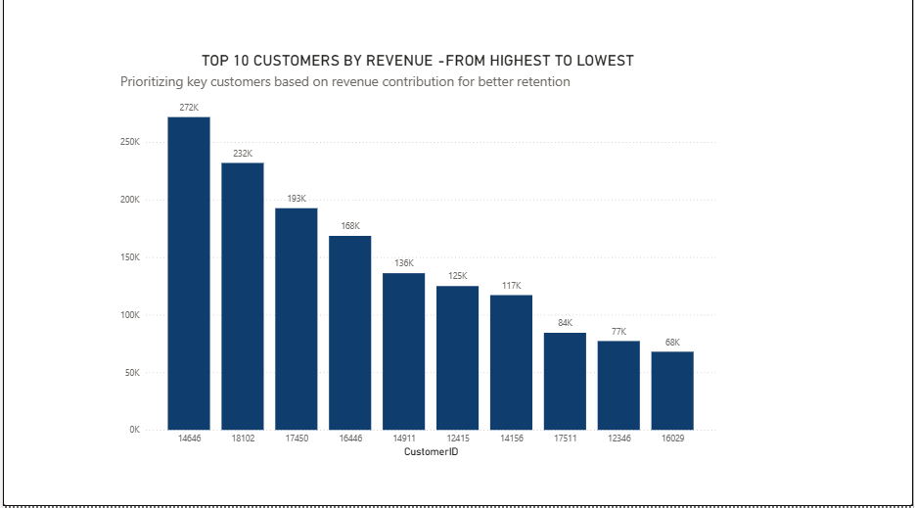
Top 10 Customers by Revenue

Slide 8
Product Demand by Country – Bubble Map (Excl. UK)
Spotting expansion opportunities based on quantity sold
Shows demand concentration by country (size of bubble = quantity).
UK excluded.
Australia, Germany, and Netherlands show strong product demand.
These regions are candidates for future distribution and targeted campaigns

Slide 9
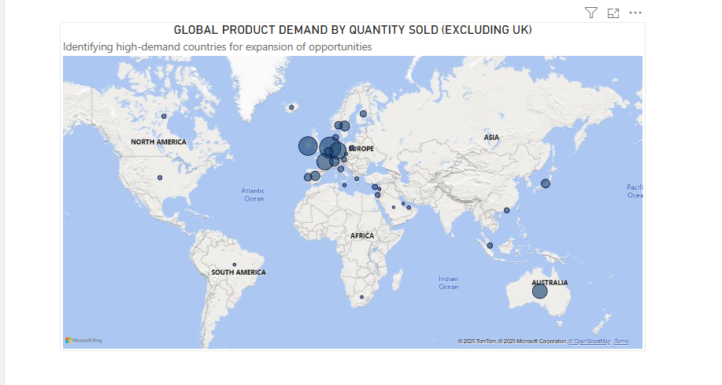
Product Demand by Country – Bubble Map (Excl. UK)

Slide 10
Conclusion & Strategic Recommendations
Revenue peaked in November, hinting at seasonal buying patterns.
The Netherlands and EIRE are high-performing non-UK markets.
A few customers contribute the majority of revenue.
Regional demand shows potential for international expansion.
Recommendation: Focus retention on key customers and expand into top-performing countries.

Slide 11
THANK YOU.

